Slide 1
1
Introduction
PATE and Private-kNN
DP-SGD
PATE
Private-kNN

Slide 2
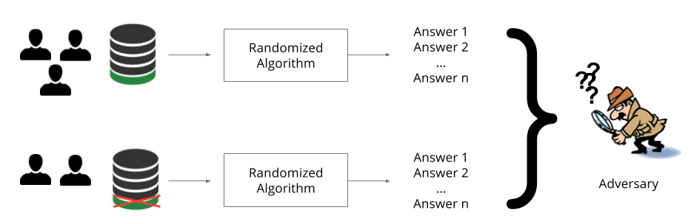
Differencing attacks
COUNT(SINGLE)
47
Introduction
DP-SGD
COUNT(SINGLE)
46
PATE
Differential privacy
Private-kNN

Slide 3
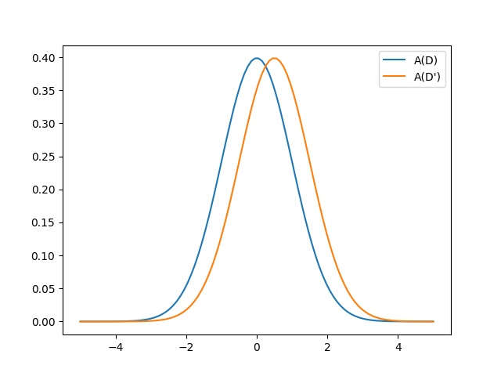
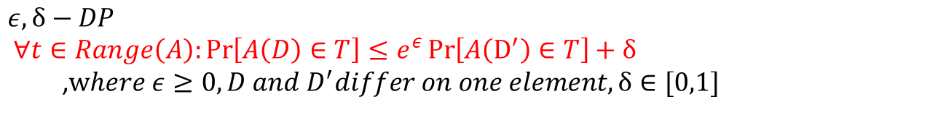
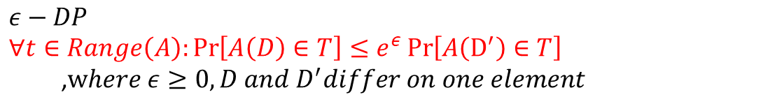
Definition
$$ε−DP$$
$∀t∈Range\left(A\right):\operatorname{Pr}\left[A\left(D\right)∈T\right]≤e^{ε}\operatorname{Pr}\left[A\left(D^{′}\right)∈T\right]$
,$where ε≥0, D and D^{′}differ on one element$
Introduction
$$ε,δ−DP$$
$∀t∈Range\left(A\right):\operatorname{Pr}\left[A\left(D\right)∈T\right]≤e^{ε}\operatorname{Pr}\left[A\left(D^{′}\right)∈T\right]+δ$
,$where ε≥0, D and D^{′}differ on one element,δ∈[0,1]$
DP-SGD
PATE
Private-kNN
The degree of similarity between two distribution

Slide 4
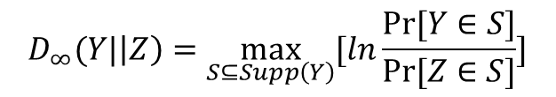

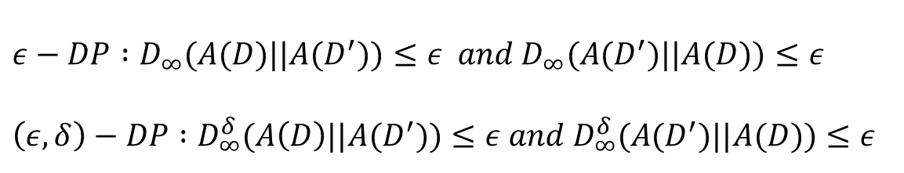
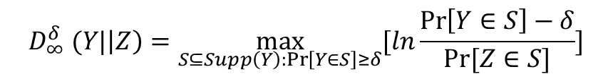
KL-Divergence
Max Divergence
$$\text{D}\text{(}\text{Y} ||\text{Z}\text{) = }𝔼_{y\sim Y}\text{[}\text{l}\text{n}\frac{\operatorname{Pr}\left[Y=y\right]}{\operatorname{Pr}\left[Z=y\right]}]$$
$$D_{∞}(Y|\left|Z\right)=\max_{S⊆Supp\left(Y\right)}{[ln\frac{Pr⁡[Y∈S]}{Pr⁡[Z∈S]}]}$$
Introduction
Not symmetric
Does not satisfy the triangle inequality
Can be infinity
$$D_{∞}^{δ} (Y|\left|Z\right)=\max_{S⊆Supp\left(Y\right):\operatorname{Pr}\left[Y∈S\right]≥δ}{[ln\frac{\operatorname{Pr}\left[Y∈S\right]−δ}{Pr⁡[Z∈S]}]}$$
DP-SGD
$$ε−DP :D_{∞}(A(D)||A(D^{′}))≤ε and D_{∞}(A(D^{′})||A(D))≤ε$$
$$\left(ε,δ\right)−DP :D_{∞}^{δ}(A\left(D\right)||A(D^{′}))≤ε and D_{∞}^{δ}(A(D^{′})||A(D))≤ε$$
PATE
Private-kNN
Additional
Some looser definition such as CDP(Concentrated DP),zCDP(Zero-Concentrated DP),RDP(Rényi DP) and etc. are defined by other distance measures

Slide 5
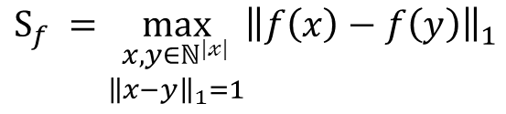
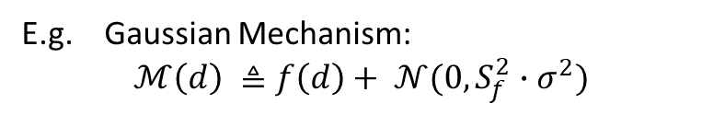
How?
Add noise
NOISY_COUNT()
46.5
Introduction
DP-SGD
NOISY_COUNT()
46.5
PATE
How Much?
Sensitivity
Private-kNN
$$S_{f} =\max_{\begin{aligned}x,y∈ℕ^{|𝓍|} \\ {\left\|x−y\right\|}_{1}=1\end{aligned}}{{\left\|f\left(x\right)−f\left(y\right)\right\|}_{1}}$$
E.g. Gaussian Mechanism:
$$ℳ\left(d\right) ≜f\left(d\right)+ 𝒩(0,S_{f}^{2}∙σ^{2})$$
$$NOISY_COUNT\left(d\right) ≜COUNT\left(d\right)+ 𝒩(0, 1∙σ^{2})$$

Slide 6
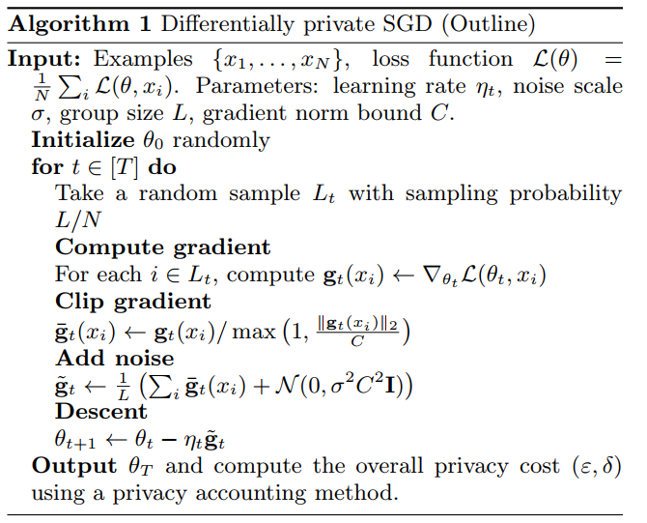
DP-SGD(Noisy SGD)
Sample a minibatch
Compute loss and gradient of the loss
Clip gradients per example
Add random noise to the clipped gradients
Update model parameters
Introduction
DP-SGD
PATE
Private-kNN

Slide 7
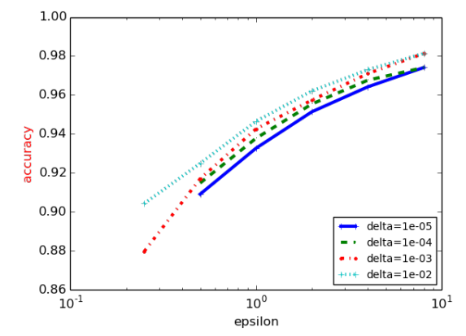
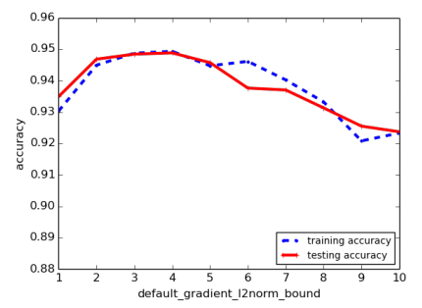

Evaluation
Introduction
DP-SGD
PATE
Private-kNN

Slide 8
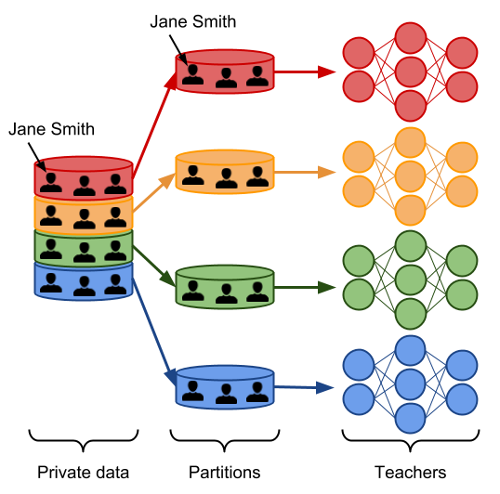
PATE ：Private Aggregation of Teacher Ensembles
Introduction
DP-SGD
PATE
Private-kNN
Partition dataset in subsets with no overlap
Train teacher models on subset separately

Slide 9
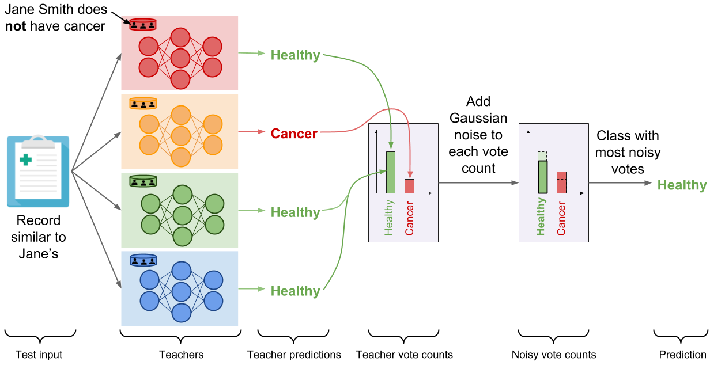
Introduction
DP-SGD
PATE
Private-kNN
Aggregate predictions made by each Teacher
Add noise to prediction aggregation

Slide 10
Limitation
Each prediction made by the aggregation mechanism increases the total privacy budget
Teacher models contains parameters trained on private data
Introduction
DP-SGD
PATE
Private-kNN

Slide 11
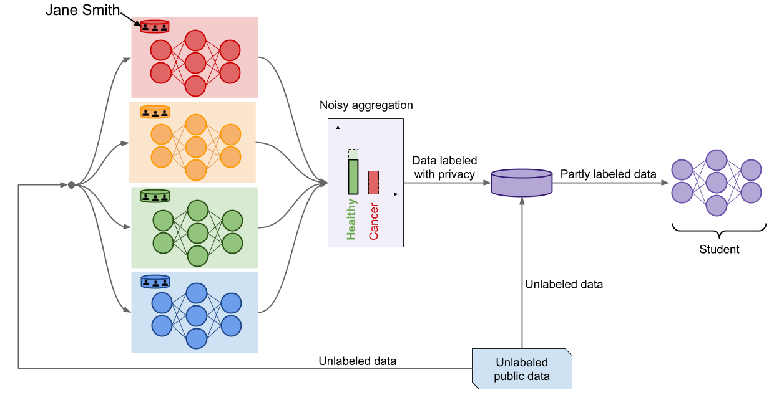
Introduction
DP-SGD
PATE
Private-kNN
Train student Model with unlabeled data and data labeled by aggregation mechanism

Slide 12
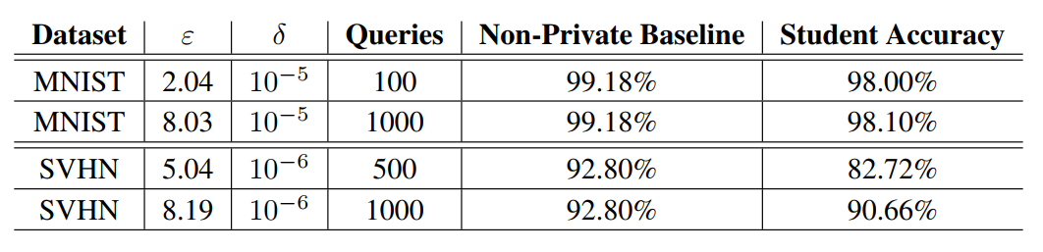
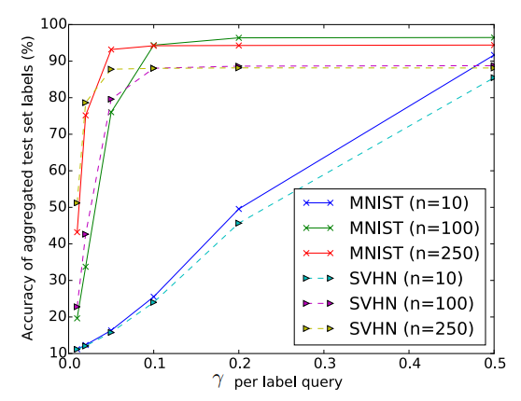

Evaluation
Introduction
DP-SGD
PATE
Private-kNN

Slide 13
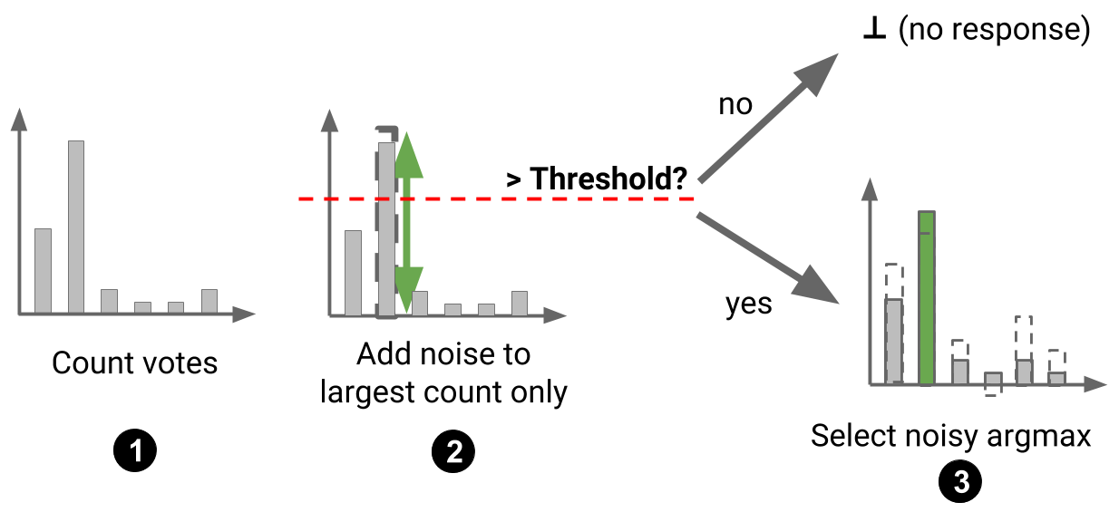
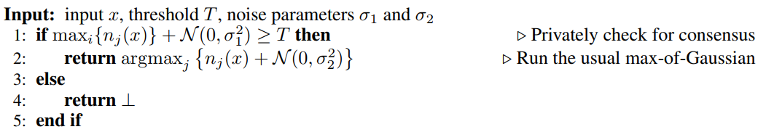
Optimization to PATE
the Confident Aggregator
Introduction
High consensus among teacher means low privacy loss
DP-SGD
PATE
Private-kNN

Slide 14
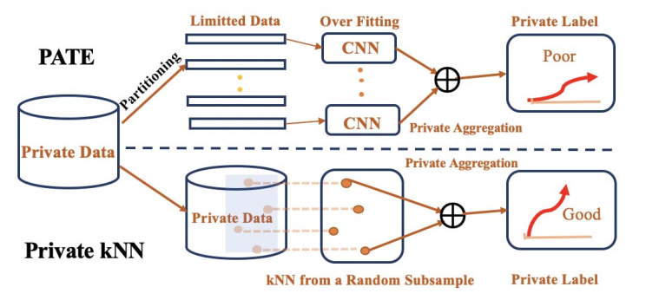
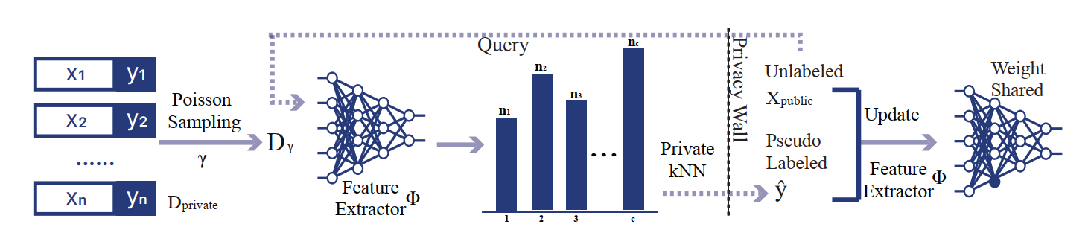
Private-kNN: Practical Differential Privacy for Computer Vision at CVPR 2020
Introduction
DP-SGD
PATE
Private-kNN

Slide 15
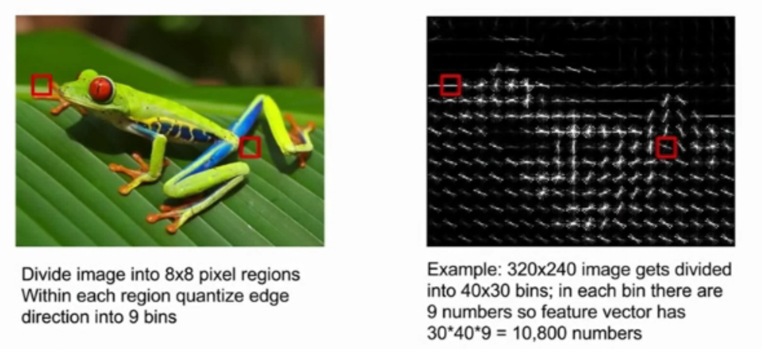
Additional
Histogram of Oriented Gradients (HOG)
Introduction
DP-SGD
PATE
Private-kNN

Slide 16
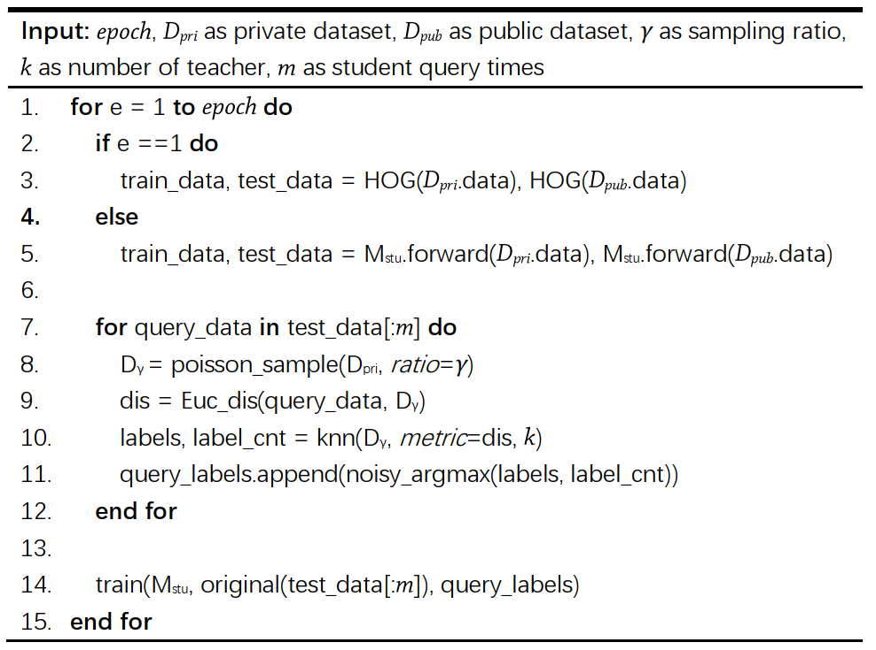
Introduction
DP-SGD
PATE
Private-kNN

Slide 17
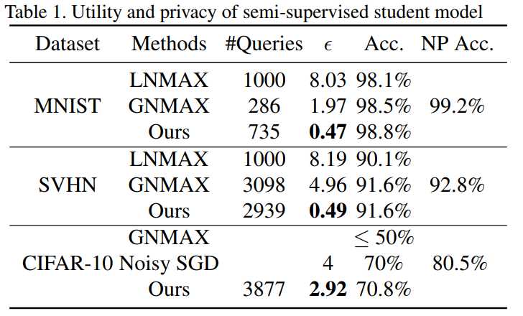
Evaluation
Introduction
DP-SGD
PATE
Private-kNN

Slide 18
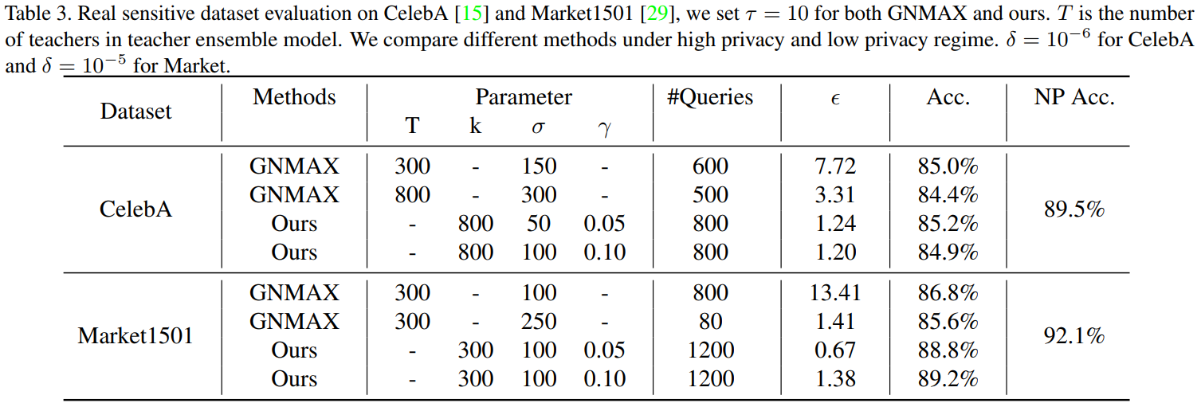
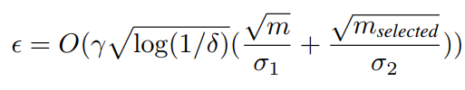
Evaluation
Introduction
DP-SGD
PATE
Private-kNN

